Slide 1




PPI Connect
Decision Tool for Voluntary & Community Based Organisations

Slide 2
About this Tool
Requests to link researchers with communities are growing. This has created an associated burden for some voluntary and community-based organisations.
This decision tree was developed to aid these organisations to prioritise which approaches from researchers may be of their benefit to invest time in.
This decision tree is available to freely use and adapt and is licensed under a CC BY 4.0 license.

Slide 3
This tool is designed to help voluntary and community-based organisations handle PPI-related requests from researchers for connections or introductions to their communities.
Apply the decision tool to each request your organisation receives from researchers. The intent is to help process the requests in a way that ensures mutual benefit to the organisation
It was co-designed with members from PPI Ignite Network @ UCD, UCD, Alzheimer Society of Ireland, Barnardos, Care Alliance Ireland, Family Careers Ireland, Fighting Blindness, Health Research Charities Ireland, Muscular Dystrophy Ireland, Sage Advocacy and Transgender Equality Network Ireland

Slide 4
This tool is designed to help voluntary and community-based organisations handle PPI-related requests from researchers for connections or introductions to their communities.
Apply the decision tool to each request your organisation receives from researchers. The intent is to help process the requests in a way that ensures mutual benefit to the organisation
It was co-designed with members from PPI Ignite Network @ UCD, UCD, Alzheimer Society of Ireland, Barnardos, Care Alliance Ireland, Family Careers Ireland, Fighting Blindness, Health Research Charities Ireland, Muscular Dystrophy Ireland, Sage Advocacy and Transgender Equality Network Ireland

Slide 5
Standard Version
Also available as a PDF

Slide 6
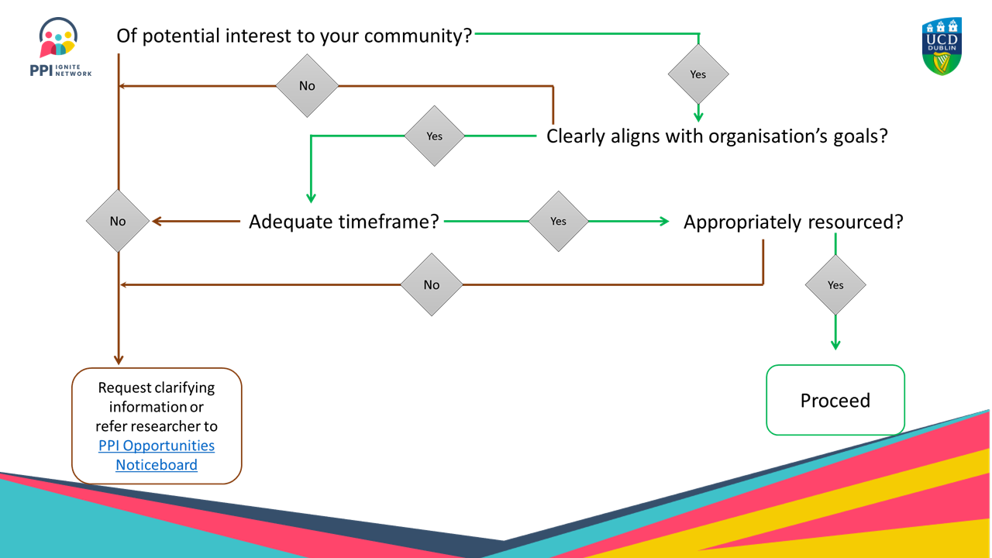

Slide 7
Editable version
Amend as necessary for your organisation or context

Slide 8
Amendments to the decision tree
The decision tree is provided as an editable version.
An organization may want to add specific lines expanding on resources of importance to them, for example, materials, labour, staff, and skills
Other organisation may expand on budget, with a separate line for budget for charity costs and remuneration of PPI contributors
No two organisations are the same. Use and amend this tool as relevant to you and your organisation

Slide 9
Of potential interest to your community?
Yes
No
Yes
Clearly aligns with organisation’s goals?
No
Adequate timeframe?
Yes
Appropriately resourced?
No
Yes
Request clarifying information or
refer researcher to PPI Opportunities Noticeboard
Proceed

Slide 10


PPI Ignite Network @ UCD
is funded by
  Health Research Board,
  Irish Research Council and
  UCD Dublin
For more information see: www.ucd.ie/ppi/
Contact: ppi@ucd.ie

